Slide 1
Administering Medication in Early Childhood Care; Identification and Care of Children

Slide 2
First things first…
If a medication can be given at home and not brought into the center at all, this is ideal.
For example: medications prescribed to be taken three times a day (TID) could be given at home: before center, after center, and in late evening/bedtime.
Discuss with parents these options before making the decision to store and administer a medication at center.
Home before child-care center if possible!
(We know this isn’t always possible.)

Slide 3
Medication Assistance
Performance Standard
1304.47(b)(4)(i)(C)(D)(3)(e)(2)
Minimum Standard§
746.3801, §746.3803-3807,3809,3811, 3815,3817,3818, 3819
Policy Statement: UTRGV-PS.JA ISD-EHS-CCP Program staff will administer medication to children as per Licensing Requirements.

Slide 4
Medications in child-care center
Prescription (ordered by a health care provider…MD, dentist, nurse practitioner, physician assistant)
ADHD meds: most are a controlled substance (oral, transdermal patch)
Antibiotics (oral, ear drops, eye drops)
Anti-seizure meds (oral, rectal-Diastat™)
Diabetic meds: insulin, Glucagon® (injections)
Asthma meds: (inhaled, oral)
EpiPen® (injection)
Others
OTC (over the counter) medications
Acetaminophen (Tylenol®)
Ibuprofen (Advil®, Motrin®, etc.)
Cetirizine (Zyrtec®)
Diphenhydramine (Benadryl®)
Others

Slide 5
What authorization must I obtain before administering a medication to a child in my care?
(a) Authorization to administer medication to a child in your care must be obtained from the child' s parent:
In writing, signed and dated;
In an electronic format that is capable of being viewed and saved;
By telephone to administer a single dose of a medication.
Authorization to administer medication expires on the first anniversary of the date the authorization is provided.
The child's parent may not authorize you to administer medication in excess of the medication' s label instructions or the directions of the child's health­ care professional.
Parent authorization is not required if you administer a medication to a child in a medical emergency to prevent the death or serious bodily injury of the child, provided that you administer the medication as prescribed, directed, or intended.

Slide 6
How must I administer medication to a child in my care?
(b) Medication must be given:
As stated on the label directions;
As amended in writing by the child's healthcare professional
(c) Medication must:
Be in the original container labeled with the child's full name and the date brought to the operation;
Be administered only to the child for whom it is intended;
Not be administered after its expiration date.

Slide 7
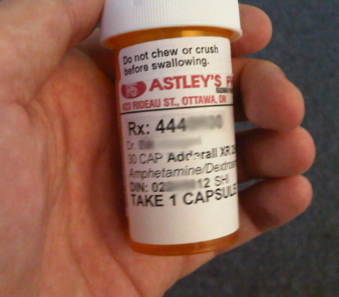
When you administer medication to a child in your care, you must record the following:
Full name of the child to whom the medication was given;
Name of the medication;
Date, time, and amount of medication given;
Full name of the employee administering the medication.
You must keep all medication records for at least three months after administering the medication.
Document on Caregiver's Record of Administering Medication (CCL 7238)

Slide 8
How must I store medication that I administer to a child?
Keep it out of the reach of children or in locked storage;
Store it in a manner that does not contaminate food;
Refrigerate it, if refrigeration is required, and keep it separate from food.

Slide 9
How long may I keep the medication that I administer to a child?
You must dispose of the medication or return it to the parent when the child withdraws from the child-care center, or when the medication is out-of-date or is no longer required for the child.

Slide 10
What is specialized medical assistance?
Specialized medical assistance is any medical assistance other than medication. Examples include, but are not limited to, assisting with an apnea monitor, protective helmet, or leg brace.

Slide 11
What are my requirements regarding specialized medical assistance?
If a child in your care requires specialized medical assistance, (example, Plan of actions, seizure, asthma, allergy) then you are required to provide specialized medical assistance as recommended or ordered by a health-care professional.
If you are provided with a written copy of the health-care professional's recommendations or orders, you must maintain this written information in the child's record for at least three months after the health-care professional has indicated that the specialized medical assistance is no longer needed.

Slide 12
The Five "R"s:
Know the five "R's" of medication administration
Right child,
Right time,
Right dose,
Right route, and
Right medication.
Medications are serious business…even OTC ones

Slide 13
Cont.
Designated staff will administer medication and document on the Medication Administration Log:
the name of the child, medication, physician, then the prescription number, expiration date, dosage, time to be administered and date medication administration ends.
Staff will check the allergy list to make sure the child is not allergic to medication.
Each time medication is administered staff will document the date, their name, signature, dosage and time given on the Medication Administration Log.
Staff will not administer medication to a child who is crying or fighting. This increases chances of choking. Notify the physician and determine administration of medication.

Slide 14
Cont.
Staff will use Medication Administration Log and document not given, the reason, and notify parents and physician when medication is given.
Staff will document on the Medication Administration Log any observable side effects and notify accordingly.
Staff will document identified side effects on Incident Report, notify parent immediately and give them a copy.

Slide 15
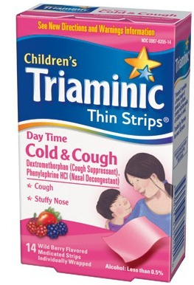
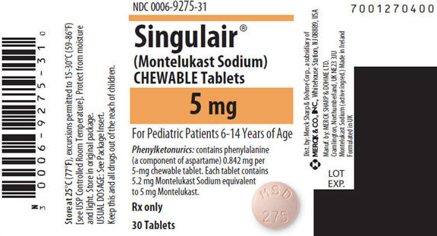
Tablets & Capsules
Most oral tablets and capsules should be taken with water.
Rule of thumb, give with water unless otherwise directed.
Chewable tablets should be chewed until they are dissolved completely. They are not meant to be swallowed.
Some “soft chew” medications are meant to melt in your mouth or be chewed.

Slide 16
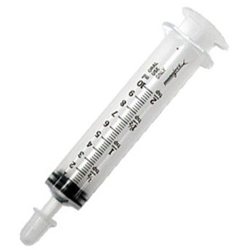
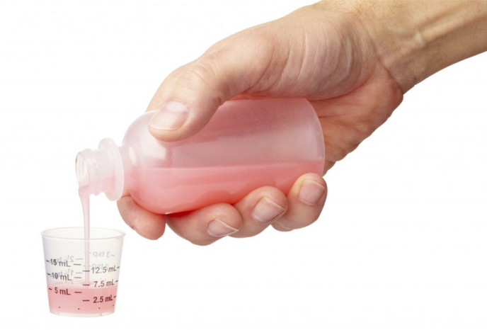
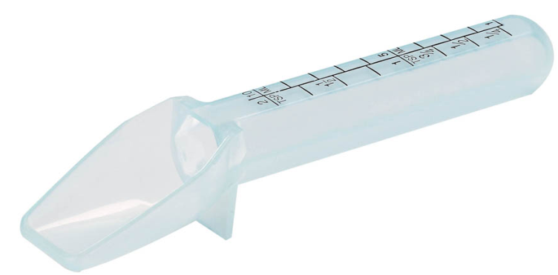
Liquid medications
Liquid medications:
Only use measuring devices made for medications.
Household teaspoons are not an accurate method to measure meds.
Shake the bottle if indicated as some medications settle to the bottom.
Measure at eye level.
Place on flat surface and crouch down so you are eye level with the measuring device (preferred method).

Slide 17
Know your conversions
Be sure you know the correct dose. Don’t guess!

Slide 18
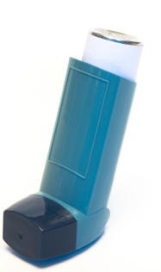
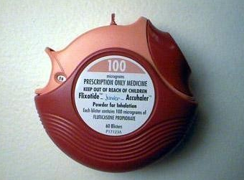
Inhaled medications
Inhaled medications are generally those used to treat asthma.
Inhalers:
Metered Dose Inhaler
Dry Powder Inhaler
Metered Dose Inhaler with Spacer

Slide 19
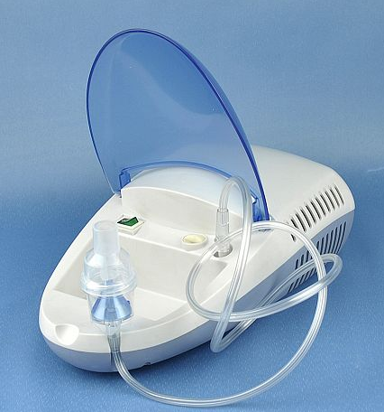
Inhaled medications
Nebulizers:
Mask
Nebulizer
Machine
Mouthpiece

Slide 20
setting
Medication administration should be conducted in a quiet, private place.
Privacy of student
No distractions

Slide 21
Do’s and don’ts
DON’T…
Give a child’s somebody else’s medication
Skip a dose
Crush or break pills unless instructed to by a medical provider/pharmacist
Change the dose or timing
Give medication that is not in original package, bottle or container
DO…
Know the medication you are giving
Give the medication exactly how it’s prescribed
Have a written order from a medical provider
Follow the 5 “R”s Rights
Watch expiration dates
Give in private, non-distracting setting

Slide 22
Procedure for Medication Error Form
Staff will notify the child's physician and follow his/her instructions.
Staff will know the name of the medication and the dosage given.
Staff will notify the child's parents and explain the error.
Staff will notify Center Manager/Director.
Staff will document using the Medication Error Form.
Staff will use the Incident Report to document the time child left the center with the parent and the child's condition at the time he/she left (alert, talking, no apparent effects of medication, drowsy, slurred speech, recognized parent, or taken to hospital at 3:20 P.M., etc.).
Notify the Director/Center Manager and the Grantee Directors.

Slide 23
documentation
Factual information, no opinions.
Never white out, scribble over, cover up, or erase what has already been written.
If error in documentation, draw single line through incorrect information and initial.
Don’t use abbreviations.
Write legible so it is easy to read.
Black or blue ink is best, if handwritten. No pencil.
Computerized: nothing that has previously been a part of the child’s medical file should ever be deleted.
RULE OF THUMB…
“IF IT’S NOT DOCUMENTED, IT’S NOT DONE”!

